Slide 1




Macrosystems EDDIE:
Getting Started + Troubleshooting Tips
Developed by K.J. Farrell and C.C. Carey for use with Macrosystems EDDIE modules.
http://module1.macrosystemseddie.org
Module development supported by NSF EF 1702506.
Last updated: 19 Nov. 2018
Notes:
Welcome the students to class. It might be helpful to go around the room and briefly discuss if anyone has experience programming or modeling. The point of this is to emphasize that most students are likely novices, and that asking lots of questions is ok because their peers are novices as well.
It is really important at this point to emphasize that there will be lots of new material covered during this module, and that going slowly and asking for help is very much encouraged!

Slide 2


R and RStudio
R
RStudio
Statistical environment
Point and click program for using R in one place
  Run code
  Visualize plots
  Access files
Check-in:
Have you downloaded both R and RStudio?
Look in your Applications (Mac) or in the Start menu (Windows) to confirm this-- both programs should be listed.
If either program is missing, install it now!

Slide 3
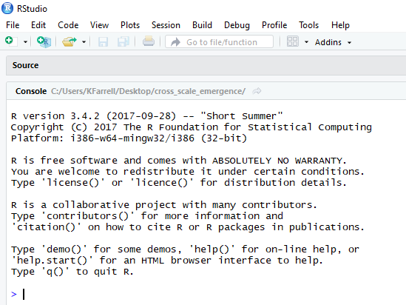
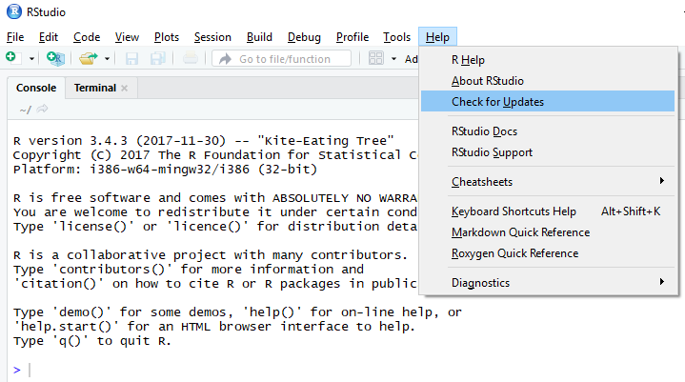
Are R & RStudio up to date?
Check that R and RStudio are both up-to-date, and download new versions if necessary
  When you open RStudio, you will see your version of R. It should be at least 3.5.1
  Check for updates to RStudio by clicking Help, then Check for Updates

Slide 4
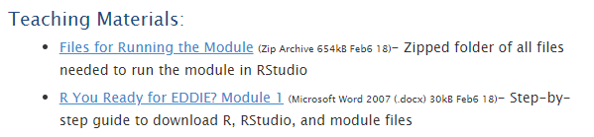
Download the module files
Navigate to the Macrosystems EDDIE Module 1 website
  http://module1.macrosystemseddie.org
Scroll down to Teaching Materials and click Files for Running the Module
Save the .zip folder to your Desktop

Slide 5
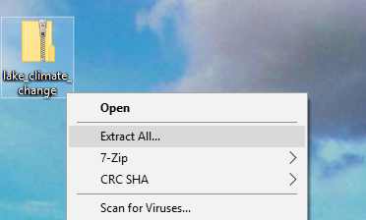
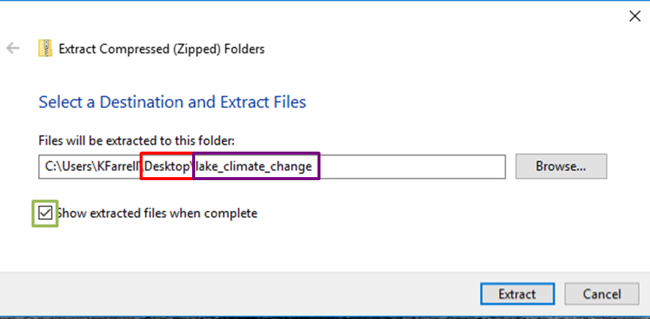
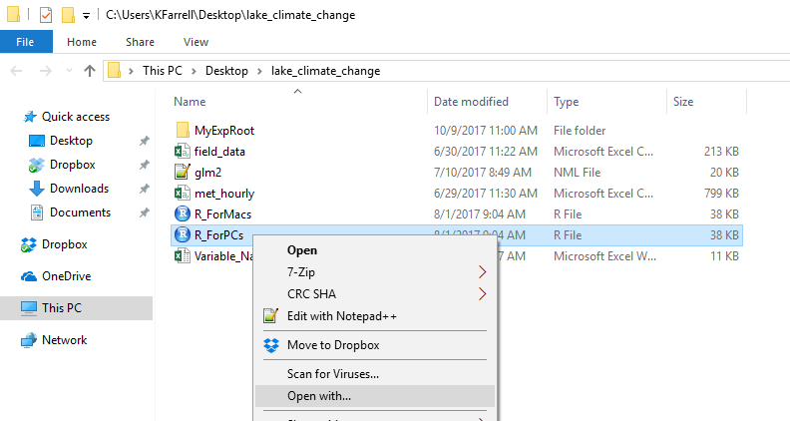
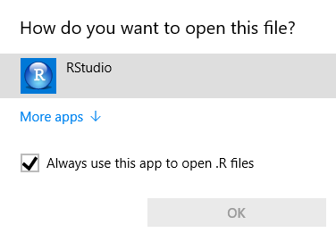
Unpack Files to Desktop: Windows
Download the zip folder directly to Desktop (or move folder from Downloads to Desktop)
Right click on the .zip folder and choose Extract All
Check that your files are:
- being extracted to the Desktop
- end exactly lake_climate_change.
Also check the box
“Show extracted files when
complete”
To open the module script in RStudio, right click on the file name (e.g., R_Script), then choose Open with… and RStudio
1)
2)
3)
4)

Slide 6
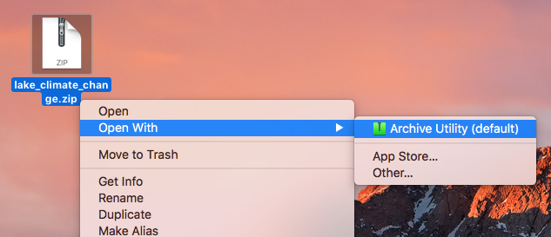
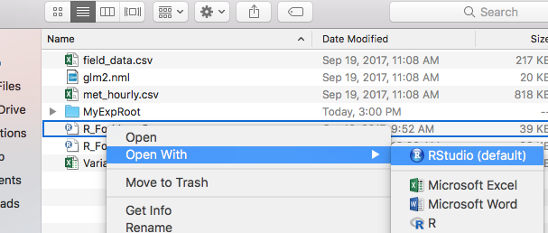
Unpack Files to Desktop: Mac
Download the zip folder directly from the Macrosystems EDDIE website to Desktop (or move folder from Downloads to Desktop)
Note: Your folder may have automatically been unzipped when you downloaded it. If it was, drag the unzipped ‘teleconnections’ folder from Downloads to the Desktop, and skip to step 4
Control + click on the .zip folder and choose Open with → Archive Utility to unzip the folder. Then double click on the unzipped folder
Check that your files are:
- being extracted to the Desktop
- called exactly lake_climate_change.
To open the module script in RStudio, control + click on the file name (R_Script), then choose Open with… and RStudio
1)
2)
4)

Slide 7
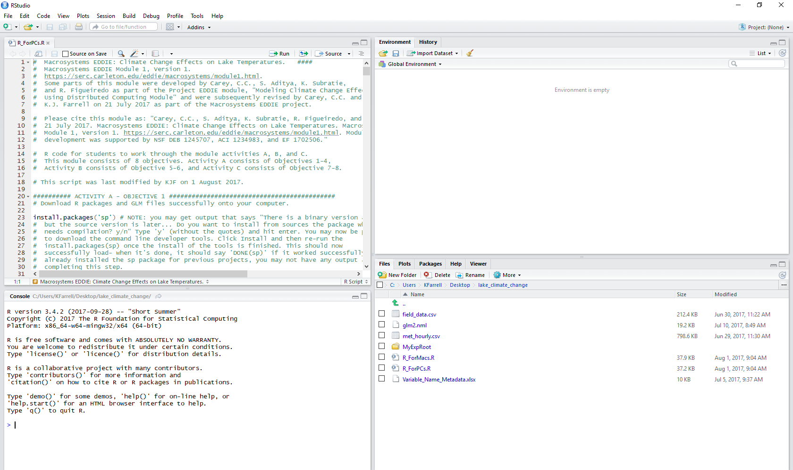
Opening Module Files in RStudio
Congrats! You’ve opened the module script in RStudio!

Slide 8
RStudio Basics: Console
The Console appears in the bottom left panel, and shows the status of your scripts. As you run the module, you will check here for confirmation messages and error codes.
You can also use the console to do math and ‘assign’ objects, which lets you save things for later.
Try typing in the following on the console:
mySum <- 2 + 2 + 4 (press Enter)
mySum (press Enter)

Slide 9
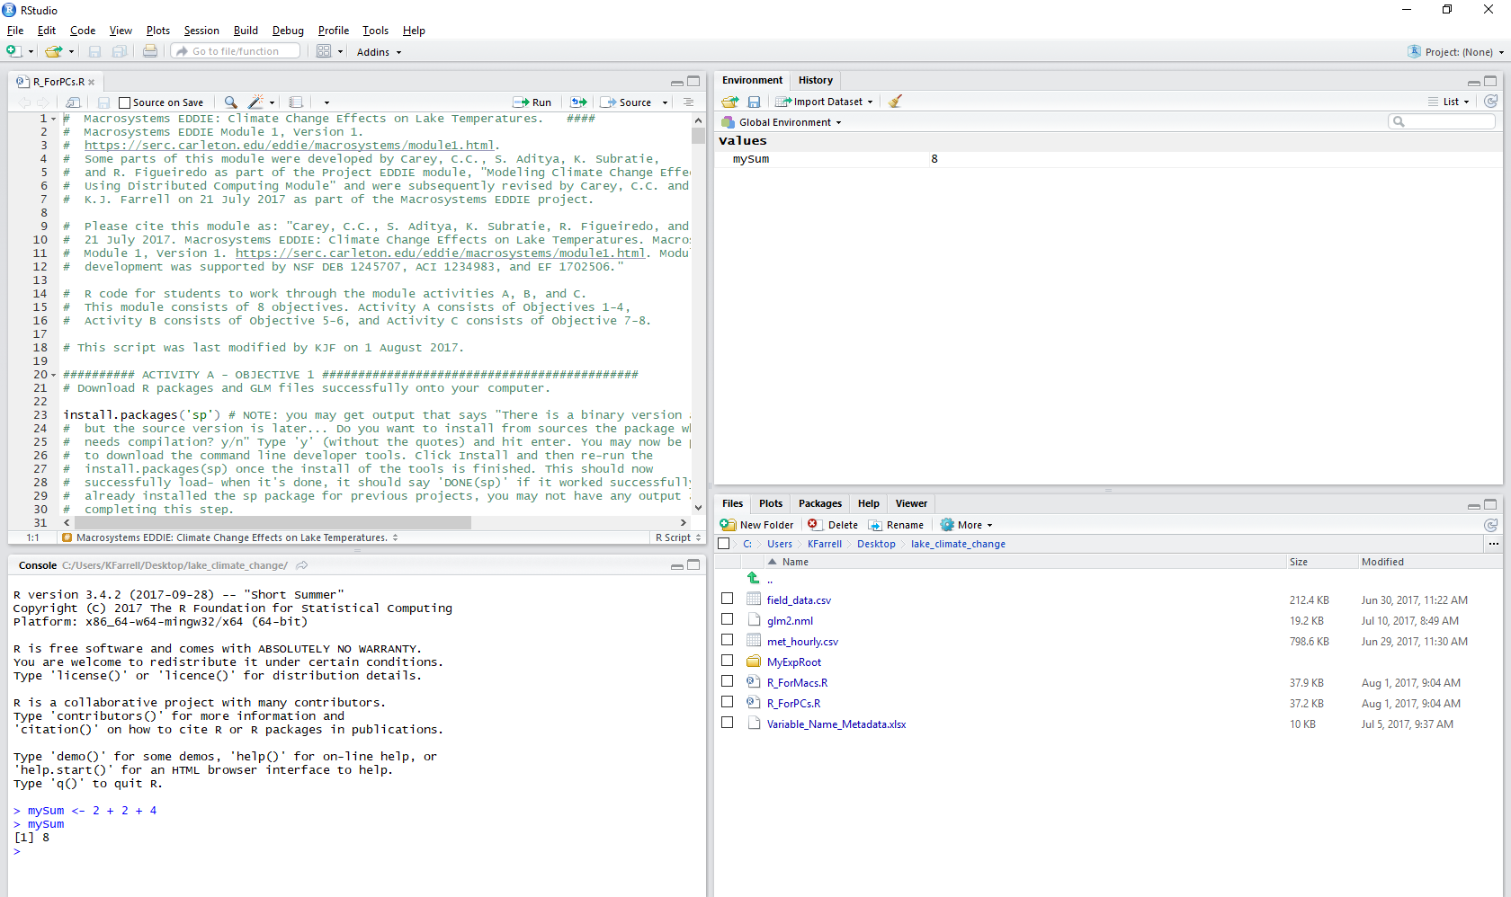
RStudio Basics: Console
Try typing in the following on the console:
mySum <- 2 + 2 + 4 (press Enter)
mySum (press Enter)
You now see that the object mySum is saved in the Environment tab, and when you type mySum into the console, you get the answer (8)!

Slide 10
RStudio Basics: Script
The Script appears in the top left panel, and shows the commands you will run for the module. As you work through the module, you will read directions in the script and execute code.
In R scripts, lines that begin with a # are not read by the program– these lines are comments or directions you need to read to move through the module.

Slide 11
RStudio Basics: Script
The Script appears in the top left panel, and shows the commands you will run for the module. As you work through the module, you will read directions in the script and execute code.
In R scripts, lines that begin with a # are not read by the program– these lines are comments or directions you need to read to move through the module.
Lines that do not begin with a # are lines of script that need to be run. You can run a line of script by putting your cursor inside the line, then pressing Run (or Ctrl + Enter)

Slide 12
RStudio Basics: Files
In the right panels (usually the bottom right), you will see a tab named Files.
This panel shows the all of the files and subfolders of your lake_climate_change folder.

Slide 13
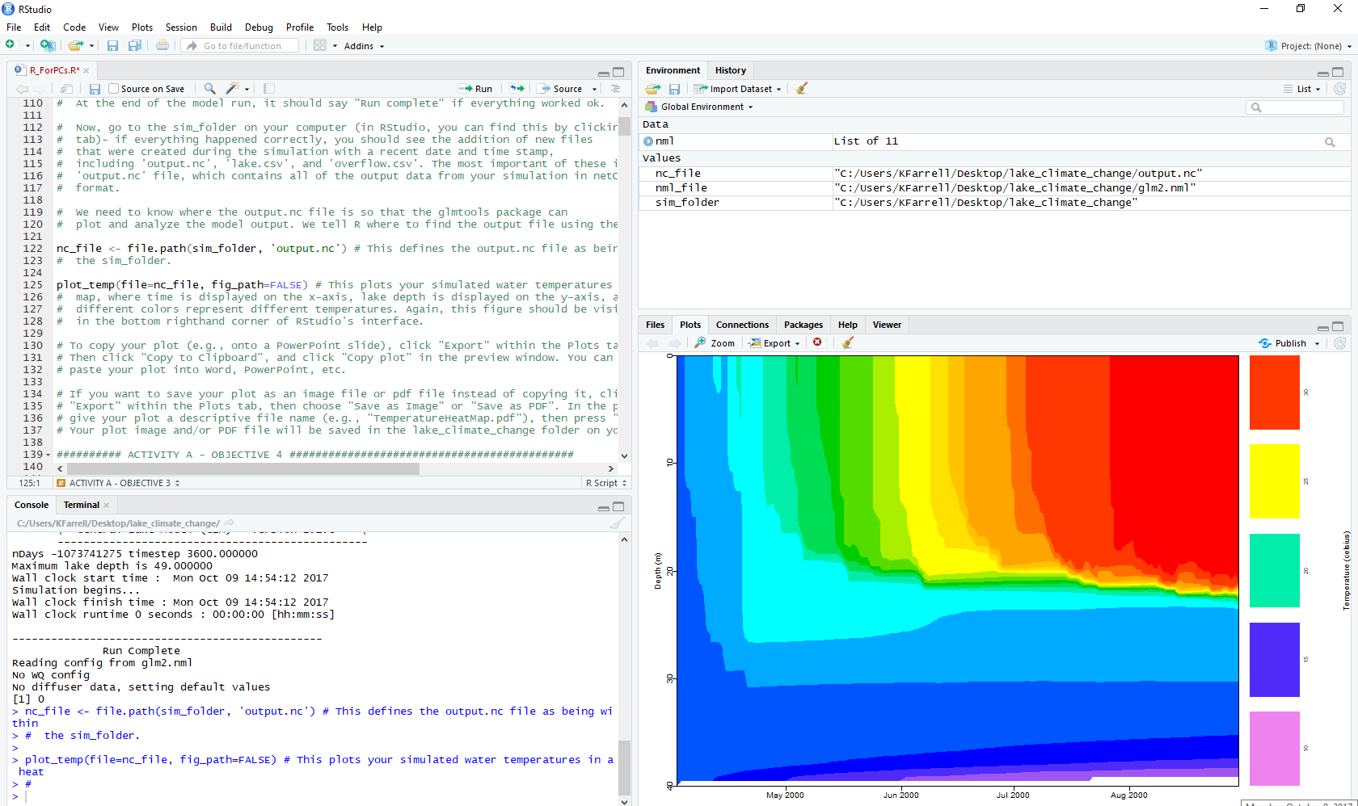
RStudio Basics: Plots
In the right panels (usually the bottom right), you will also see a tab named Plots.
This panel shows the figures you create while working through the module.

Slide 14
RStudio Basics: Plots
You can show your plot in a stand-alone window if you press the Zoom button.
If you have made more than one plot, you can toggle between them using the arrows.
You can also copy and paste your plots to another document (e.g., Word or PowerPoint), or save them to your computer using the Export command.

Slide 15
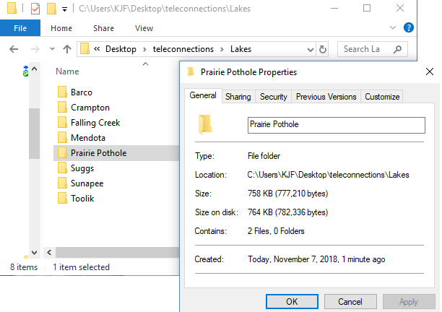
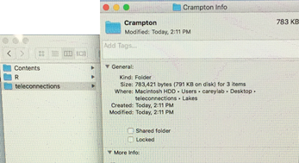
Activity A: What’s my sim_folder?
In Activity A, you need to set your sim_folder so that R knows where to find the module folders for your focal lake on your computer!
To find your folder path:
Navigate to the 'lake_climate_change' folder on your Desktop
Right click on the folder, then select Properties (Windows) or Get Info (Mac)
Look under Location (Windows) or Where (Mac) to find your folder path (examples below):
  Windows: Users/KJF/Desktop/lake_climate_change
  Mac: Users -> careylab -> Desktop -> lake_climate_change
In the R script, make sure you use the / dash, not \ (which is what Windows will show you!)
In the R script, make sure you use the / dash, not an arrow (which is what Mac will show you!)

Slide 16
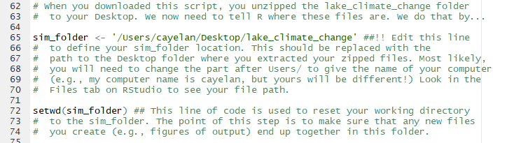
Activity A: What’s my sim_folder?
In the R script, you will need to change the part after Users/ to give the name of your computer (e.g., my computer name is cayelan, but yours will be different!).
If you don’t change this part of the sim_folder file path, your model won’t run because R won’t know where to look for your files!

Slide 17
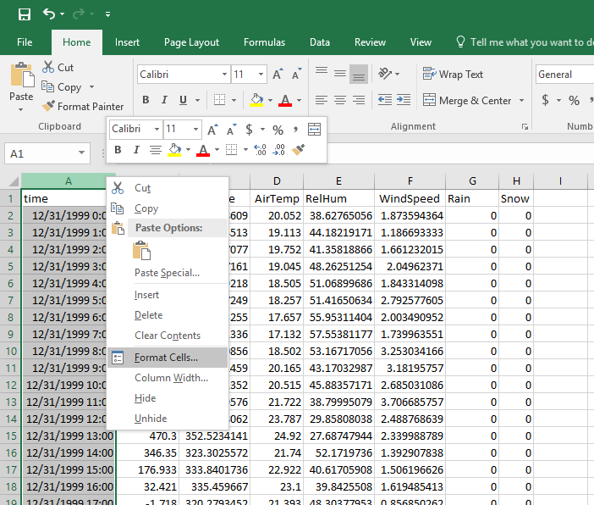
Activity B: Formatting Dates
After you’ve modified your met_hourly file for your climate scenario, you need to explicitly format your date for GLM
Right click on the A at the top of the time column, then click Format Cells

Slide 18
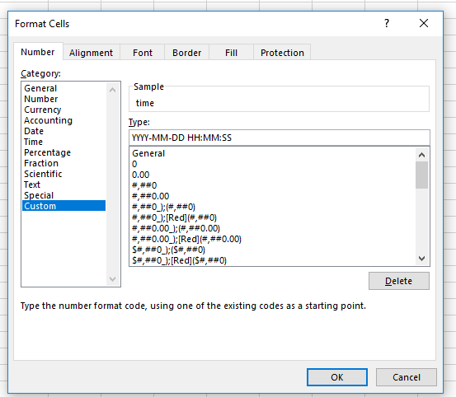
Activity B: Formatting Dates
After you’ve modified your met_hourly file for your climate scenario, you need to explicitly format your date for GLM
Click Custom, then type the correct format into the Type: box.
The format must be exactly as follows:
YYYY-MM-DD HH:MM:SS
Then press OK and save your .csv file.

Slide 19

Macrosystems eddie:
GLM Troubleshooting tips

Slide 20
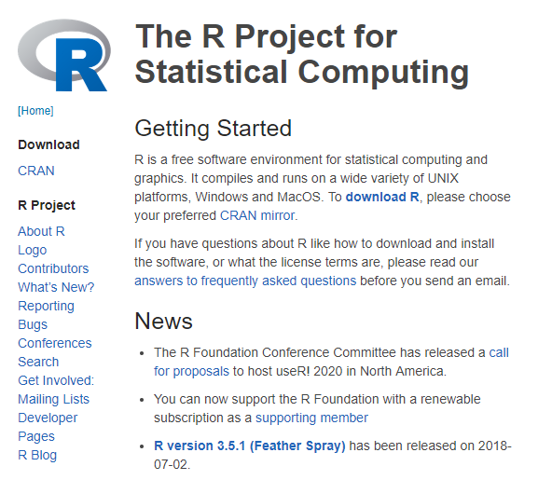
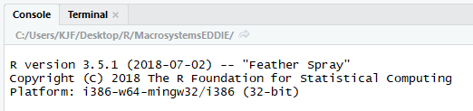
Having trouble?
If you’re having trouble running the Macrosystems EDDIE module, first double-check that you have the latest version of R!
Go to https://www.r-project.org/ and make sure that the version listed on the home page matches the version that opens when you open RStudio
If it doesn’t match, close RStudio, download and install the new version of R, then reopen RStudio and the Teleconnections_R_Script.R file
These versions must match!
Otherwise you’ll get error messages when downloading packages to run the GLM model

Slide 21
Error: gml.exe had status 309
When does it happen?
  run_glm(sim_folder, verbose=TRUE) will start the GLM run, but you will likely get an error similar to: “gml.exe had status 309”
Why?
Problem with 32-bit vs. 64-bit R in Windows 10
How to fix it:
In the RStudio menu, click on Tools, then Global Options.
In the General tab, check what R version RStudio is using (the first line at the top of the window).
If the selected version starts with [Default] [64-bit], try pressing Change and selecting the [Default] [32-bit] option. You will then need to restart RStudio and try the script again.

Slide 22
Error: Day 2451636 (2000-04-01) not found
When does it happen?
  run_glm(sim_folder, verbose=TRUE) will start the GLM run, but you will likely get an error similar to: “Day 2451636 (2000-04-01) not found”
Why?
time column in .csv file not formatted correctly for GLM
How to fix it:
Open .csv file in Excel. Right click on the time column, then select Format.
Choose Custom, then type in YYYY-MM-DD HH:MM:SS exactly. Save and close your .csv file.
Run the following lines in R to ensure your time column is formatted for GLM (search to find in the R script, then run):
  metdata <- read.csv("met_hourly_climate.csv", header=TRUE)
  metdata$time <-as.POSIXct(strptime(metdata$time, "%Y-%m-%d %H:%M:%S", tz="EST"))
  write.csv(metdata, "met_hourly_climate.csv", row.names=FALSE, quote=FALSE)
Make sure you edit the file name (in blue, above) to match your .csv file.

Slide 23
Error: "MSVCR100.dll is missing"
When does it happen?
  When you try to run GLM commands, you receive the error: “MSVCR100.dll is missing from your computer” or “The code execution cannot proceed because MSVCR100.dll was not found. Reinstalling the program may fix this problem”
Why?
The MSVCR100.dll file is missing from your Windows C++ library
How to fix it:
The missing library (MSVCR100.dll) will need to be reinstalled on your computer. This is beyond the scope of Macrosystems EDDIE troubleshooting, and we recommend you check with a campus IT worker for help.
In the meantime, we recommend partnering with a student whose computer isn’t having this problem to run the Macrosystems EDDIE module.

