Slide 1




Macrosystems EDDIE:
Climate change effects on lake temperatures
Carey, C.C., S. Aditya, K. Subratie, R. Figueiredo, and K.J. Farrell. 30 June 2017.
Macrosystems EDDIE: Climate Change Effects on Lake Temperatures.
Macrosystems EDDIE Module 1, Version 1.
http://module1.macrosystemseddie.org
Module development supported by NSF DEB 1245707, ACI 1234983, & EF 1702506
Notes:
Welcome the students to class. It might be helpful to go around the room and briefly discuss if anyone has experience programming or modeling. The point of this is to emphasize that most students are likely novices, and that asking lots of questions is ok because their peers are novices as well.
It is really important at this point to emphasize that there will be lots of new material covered during this module, and that going slowly and asking for help is very much encouraged!

Slide 2
Overview of today
Short overview of lake modeling and some background on the tools we will be working with
Activity A: Plot water temperatures from a lake model.
Activity B: Develop a climate scenario, generate hypotheses, and model how your lake responds.
Activity C: Use distributed computing to run 100s to 1000s of lake model simulations.
Notes:
Quick road map of what will be covered in the PowerPoint

Slide 3
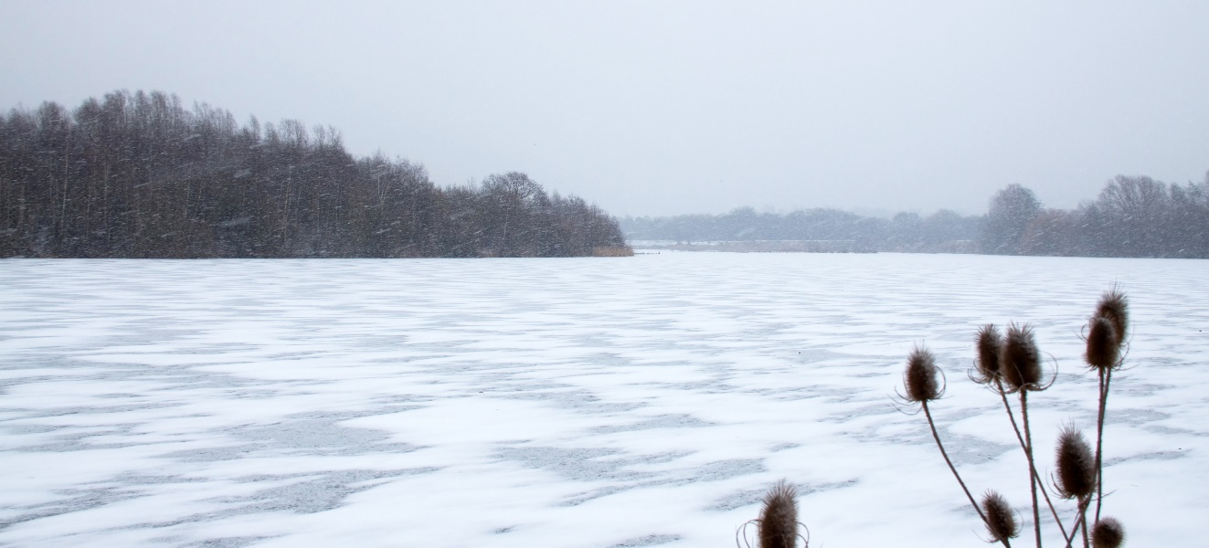
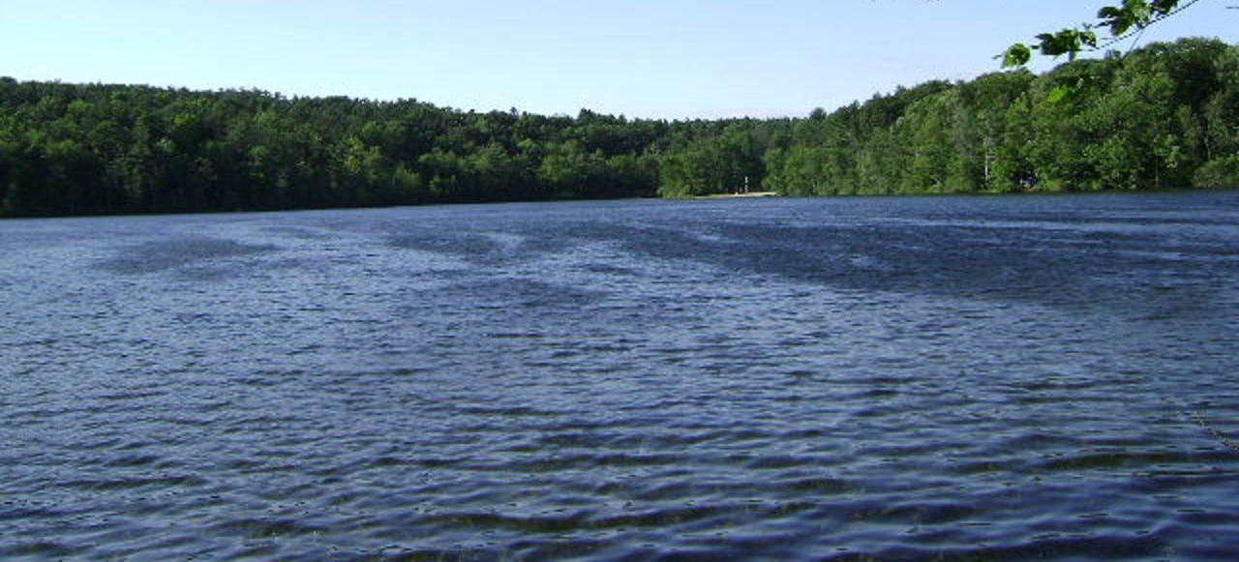
Lakes are changing worldwide…
In response to altered climate, some regions are experiencing different temperature, precipitation, and wind conditions than in the past.
Because of their position in the landscape and their thermal inertia, lakes can be powerful indicators of climate change.
Image: Wikimedia commons
Image: Wikimedia commons
Notes:
Why do we want to know how climate change is affecting lakes?
Because there is lots of variability in how climate change is occurring globally and lakes provide critical ecosystem services for humans, so we need to explore many different climate scenarios.

Slide 4
Our focal question:
How will lake thermal structure change in response to
altered climate?
Image modified from: Figure 44.10 in “Ecology and the Biosphere” (Candela Learning)
Notes:
Today, we are going to focus specifically on lake thermal structure.
Question to ask the students on this slide: what is lake thermal structure?

Slide 5
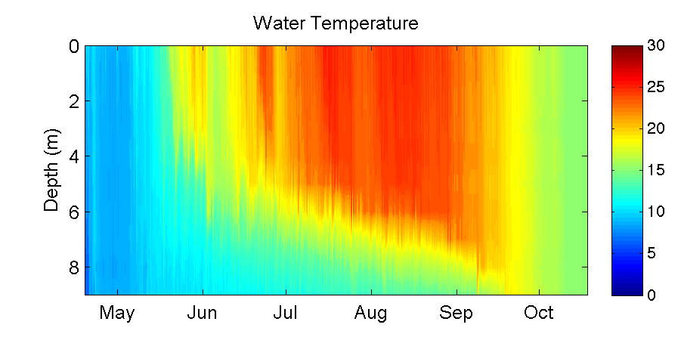
What is lake thermal structure?
Epilimnion
Thermocline
Hypolimnion
Lake Sunapee, NH, USA: data from Lake Sunapee Protective Association buoy, 2012
Notes:
Here are lake temperature data from Lake Sunapee, a large dimictic lake in New Hampshire, USA, from 2012.
Tell the students how time is on the x-axis, and depth is on the y-axis (from the surface to the sediments at 9 m depth), with color referring to the temperature, from cold 0ºC (blue) to very warm 30ºC (red). These are called heat maps or thermal plots, and we will be making lots of these figures in the module.
When we say ‘lake thermal structure,’ we are referring to both the magnitude of the water temperature in the lake at multiple depths, as well as the stratification pattern.
If a lake is thermally stratified, it exhibits distinct layers of water on a density gradient. In the summer, warmer water on top is less dense than colder water on bottom. Maximum density of water is at ~4ºC: water at 25ºC is substantially less dense than colder water, hence why it is at the surface of the lake.
Talk through the changes in thermal profiles over time in the context of water density differences among lakes.
Note! We are focusing here on thermal stratification, not chemical stratification. Density gradients due to differences in water chemistry (e.g., salinity) can be a major factor altering stratification in some lakes, but we are focusing on thermal density gradients in this module.
We are now going to introduce some terminology:
Isothermal means that the lake has the same temperature along the water depth profile, as indicated by the same color from the lake’s surface to the bottom at a certain point in time. When the water is isothermal, we assume that it is mixing, bringing oxygen from the surface to the sediments, and nutrients from the sediments to the surface.
The epilimnion encompasses the zone of the lake from the surface down to the thermocline, or the depth of maximum temperature change.
The hypolimnion is the lake zone below the thermocline.

Slide 6
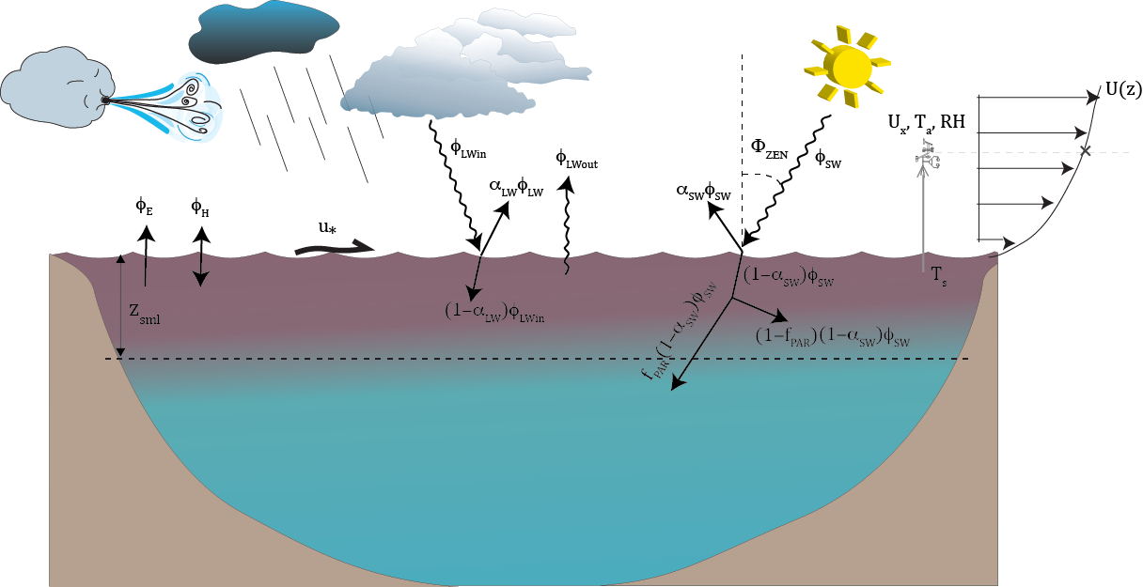
What are the drivers of thermal structure?
Solar radiation
Air temperature
Wind
Precipitation
Inflow & outflow streams
All of these factors will interact to control water temperature, thermocline depth, mixing, and more!
Figure: Hipsey et al. 2014
Notes:
Water temperature is regulated by several factors, namely, solar radiation, air temperature, wind, precipitation, and inflow/outflow streams.
All of these will interact to control thermal structure. The depth of the thermocline is regulated by solar radiation and wind-driven mixing.

Slide 7
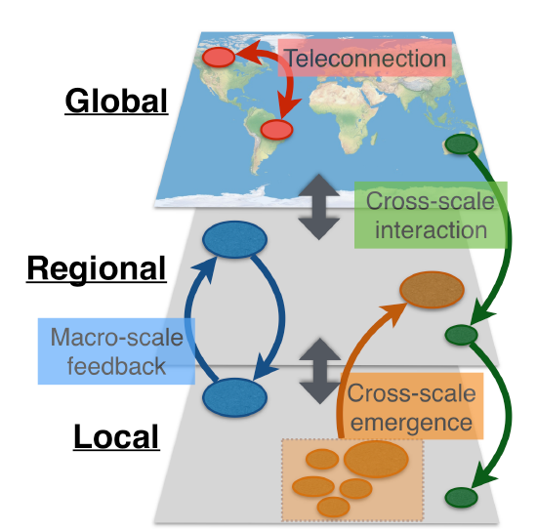
Using a macrosystems ecology approach to study lake thermal structure
Drivers of lake thermal structure occur at both local and regional scales
  Local = e.g., inflow streams
  Regional = e.g., air temperature
Macrosystems ecologists study ecological dynamics and feedbacks at multiple interacting spatial and temporal scales
We can study local and regional drivers using high-frequency sensor data + simulation models
Figure modified from: Heffernan et al. 2014
Notes:
Drivers of lake thermal structure occur at both local and regional scales: e.g., the temperature of inflowing streams and groundwater is a local factor, whereas weather/climate patterns tend to be regional.
A macrosystems ecology approach can be used to address ecological dynamics and feedbacks across multiple spatial and temporal scales.
In the case of lake thermal structure, a macrosystems approach combines high frequency sensor data and simulation models to compare the effects of local and regional drivers.

Slide 8


Models to understand multiple drivers
How can we test the effects of drivers from different scales on lake thermal structure?
  Impossible to experimentally manipulate all possible drivers in a lake!
Simulation modeling allows us to explore what would happen if we changed one driver, or multiple drivers at once
  For example, how would lake thermal structure change if air temperatures were 2°C warmer than they are now? 4°C? 6°C?
  What if rain also increased 50% on those lakes?
+2°C
+4°C
+6°C
Notes:
To study the effects of climate change on lakes, researchers use models, because it is impossible to manipulate factors such as solar radiation and wind on real lakes at the whole-lake scale in a controlled way.
However, simulation modeling allows us to test how changes in one or more drivers alters lake structure.

Slide 9


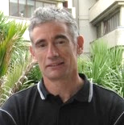
GLM: General Lake Model
Authors: Matt Hipsey, Louise Bruce, and David Hamilton
The General Lake Model (GLM) is an open-access model for simulating lake dynamics. It simulates vertical stratification and mixing and accounts for the effect of inflows/outflows, surface heating and cooling.
GLM has been designed to be an open-source community model developed in collaboration with members of the Global Lake Ecological Observatory Network (GLEON) to integrate with lake sensor data.
Available from: http://aed.see.uwa.edu.au/research/models/GLM/
Notes:
The model we are going to use is GLM (the General Lake Model), developed in 2012 as an open-source model by researchers in GLEON, the Global Lakes Ecological Observatory Network.
GLM gives us the opportunity to do climate change experiments, in which we modify different climate conditions and study their effects on the lake.

Slide 10
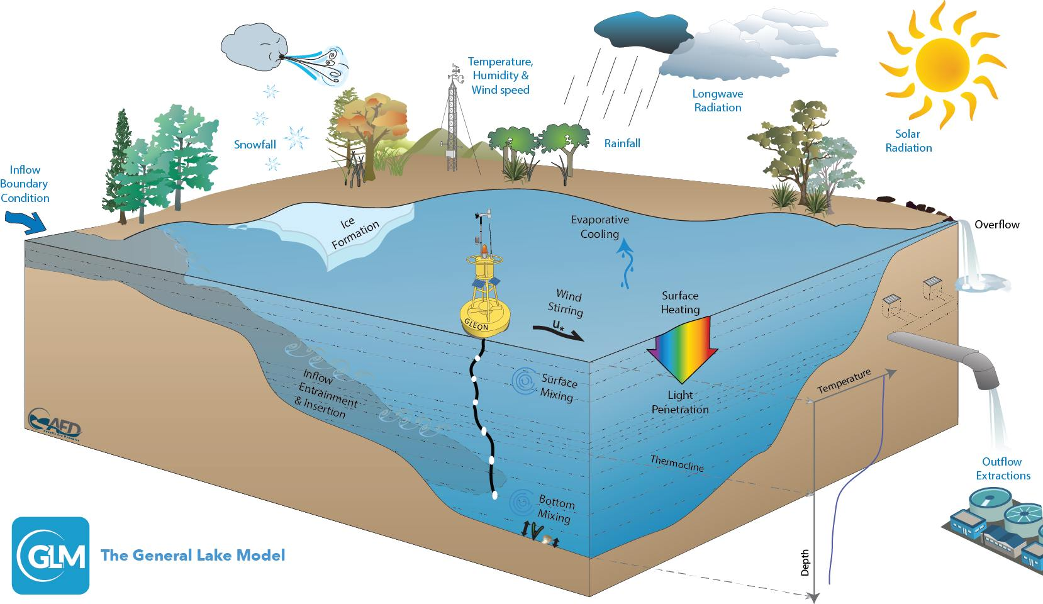
Figure: Hipsey et al. 2014
Notes:
GLM is a lake physics model, which uses climate forcing data as input (e.g., inflows, snow, wind, temperature, humidity, radiation) and models lake thermal structure, with lake temperatures as output.
GLM has a water quality model that also models water chemistry and food webs (AED), but for today, we are going to focus on lake physics.

Slide 11
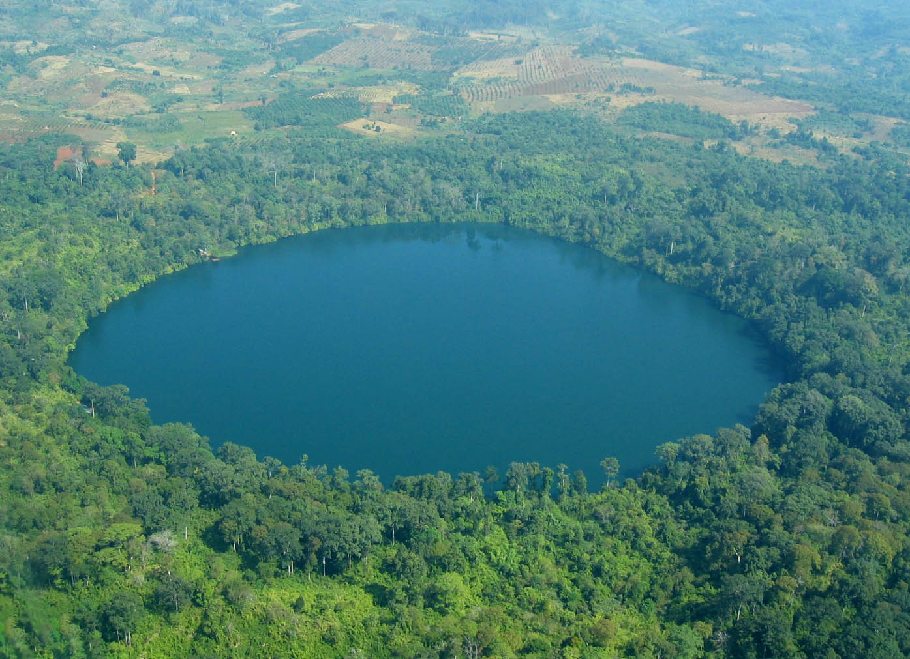
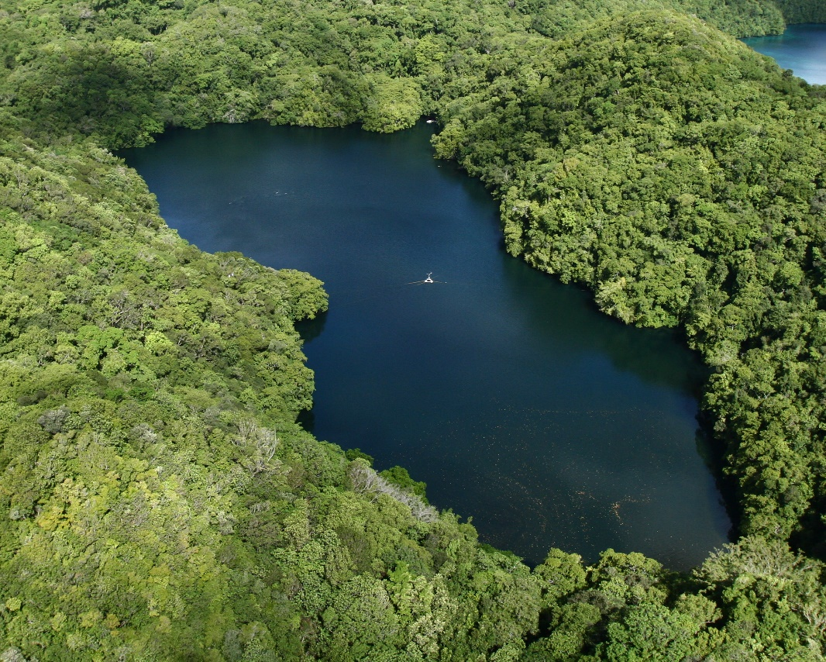
Basic structure of the model
You need to create a new folder (directory) on your computer.
Within this folder, you will have:
  A high-frequency meteorological CSV file (‘met file’) that forces the model
    e.g., “met_hourly.csv”
  An ‘nml’ text file that acts as a ‘master’ script
    glm2.nml
  High-frequency Inflow/outflow CSV files that specify the temperature and flow rate of connected streams
    Today we’re studying a closed lake without inflows or outflows
Images: Wikimedia commons
Notes:
GLM requires a separate new folder/directory on each student’s laptop, which will be downloaded as an RStudio project.
Within this folder will be:
1) a CSV (comma-separated values) file, which has the climate driver data (also referred to as a ‘met’ file; or a file with the meteorological data),
2) an .nml file, which can be opened as a text file, that acts as a master script to the GLM model (it contains parameters for how the model should work, tells the model basic info on the lake, such as depth, latitude, time period of the simulation, etc.), and
3) any inflow/outflow CSV files that specify the temperature and flow rate of the connected streams.
For the purpose of today, we are only going to have an .nml file and met .CSV file in our directory and assume that our model lake has no inflows or outflows.

Slide 12
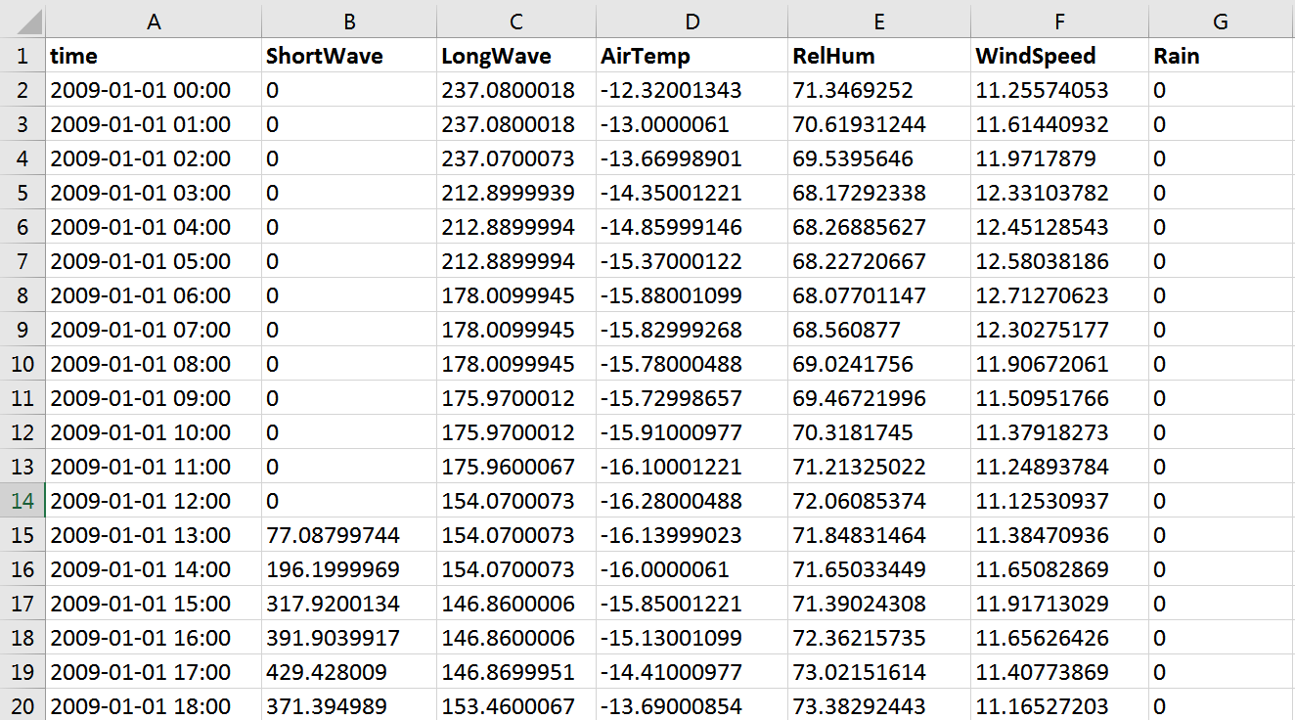
Example met file
Notes:
Here is an example met file, with columns for time step, shortwave radiation, longwave radiation, air temperature, relative humidity, wind speed, rain, and snow.
This met file is on an hourly time step.
Note the DateTime structure of the time column: GLM requires this exact format of YYYY-MM-DD hh:mm:ss. GLM also requires that the column headers are spelled exactly like what is in this file (and are capitalization-specific).

Slide 13
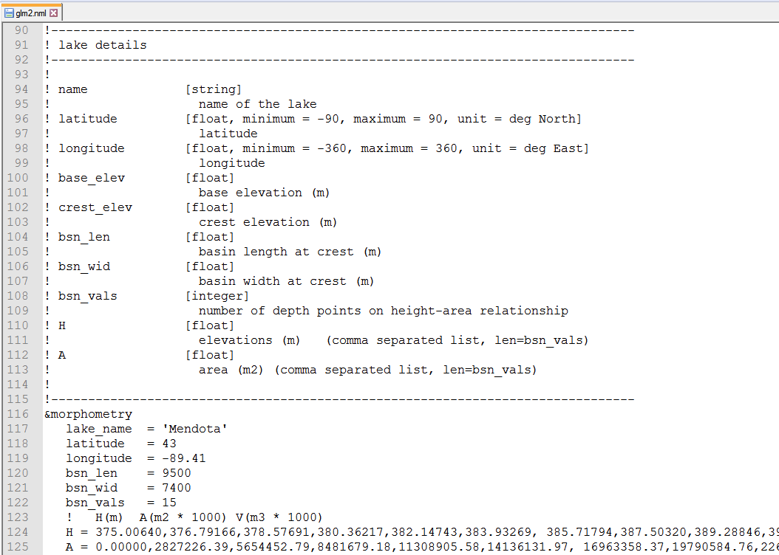
Example .nml file
Notes:
Here is an example .nml file, which goes through many required pieces of information, such as what the name of the lake being modeled is, its latitude/longitude, the time period being modeled, etc.
Fun fact: nml stands for “namelist” in the Fortran programming language.

Slide 14

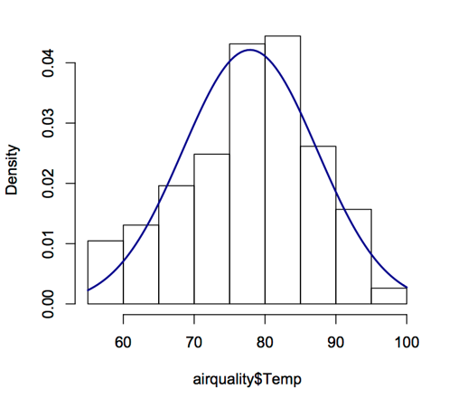
We will run GLM using R
R is a statistical environment that can run on different computer operating systems (PC, Mac, Linux)
R is reproducible, free(!), and easy to download
R can run stats, make figures, and do a suite of different analyses in many disciplines
Many packages for R to merge with other tools (including GLM!)
R is the programming language of choice for most ecologists
Notes:
We are going to run GLM in R, a programming language and statistical environment that is used for running statistics, making figures, and doing lots of different analyses.
Within R, you can download lots of different software ‘packages’ for different types of analyses.
The benefit to R is that it is free, runs on all operating systems, and is reproducible- i.e., any code that you write can be saved and run later, and you know exactly what you did!

Slide 15



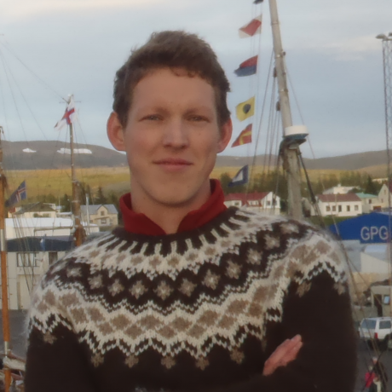
GLM-associated R packages
GLMr: holds the current version of the GLM model and allows you to run GLM on any operating system
glmtools: has different functions for analyzing and plotting GLM output from GLMr
Developed by Jordan Read and Luke Winslow
Available from: https://github.com/GLEON & https://github.com/USGS-R/glmtools
Notes:
There are two packages that we need to run GLM in R: GLMr and glmtools.
GLMr runs the model and glmtools gives you different functions for analyzing the model.
These two packages were written by Jordan Read and Luke Winslow at USGS, and can be downloaded from their Github websites.

Slide 16
Learning objectives of today’s module
Set up and run the General Lake Model (GLM) in the R statistical environment to simulate lake thermal structure
Understand how GLM configuration files, high-frequency driver data, and output files are organized and used
Modify the input meteorological data for one GLM model to simulate the effects of different climate scenarios on lake thermal structure
Interpret model output from GLM simulations to understand how changing climate will alter lake thermal characteristics
Use the GRAPLEr R package to set up hundreds of model simulations that vary input meteorological data, and run those simulations using distributed computing
Explore the application of distributed computing for modeling climate change effects on lakes
Notes:
Learning objectives!
Talk through these with the students one by one: use the embedded animations to sequentially show each of the six bullet points.
Most importantly, the goal here is to have students develop their own hypotheses for how climate change can affect lakes, and then test their hypotheses by creating a climate scenario and forcing the lake with that scenario.
They will then make mini-presentations to share their model findings with the class before learning new distributed computing technology tools to run hundreds of simulations.

Slide 17
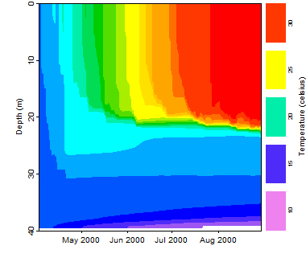
Activity A
With a partner (work in pairs):
Download the zipped folder of R scripts and other files to run this module. Extract to your Desktop
Download GLM files and R packages onto your computer
Run the model and look at the thermal output
Examine how your model output compares to the observed field data for your lake
Notes:
Introduce Activity A, which has four objectives (have students work in pairs).
Download and extract the GLM files and R packages successfully onto your computer
Explore the example model files– challenge students to figure out where on the globe “Awesome Lake” is!
Run the model and look at the thermal output
Examine how your model output compares to the observed field data for your lake
At this point, stop the PowerPoint and let the students get started on Activity A.

Slide 18
Activity B
Develop a climate scenario for any region and explore how it will affect lake thermal structure
  Develop a hypothesis about how climate change (e.g., altered temperature) may alter lake thermal structure
    Create a corresponding meteorological input file
  Run your model and examine the lake’s response:
    How does your scenario alter the temperature profile in your lake over time?
    How does the thermocline depth change?
    How does the timing of stratification and evaporation change?
  Compare the modeled output to the observed data
  Create a few figures to highlight your climate scenario and share with the class!
Notes:
Introduce Activity B, which has two objectives:
Develop a climate scenario for any region and explore how it will affect lake thermal structure.
Create figures to share with the class that demonstrate the model output for the climate scenario.

Slide 19
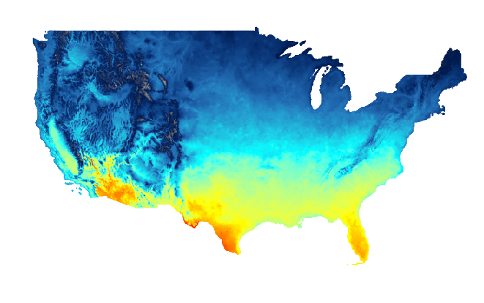
Need ideas for a climate scenario?
Check out climatedata.us
  Temperature & precipitation predictions for US across the year under different emission scenarios
  For global projections, try: climatemodels.uchicago.edu/maps
Image: climatedata.us
Notes:
Students might find this website helpful for thinking through predicted climate change in their home region, or other areas. Note that on this second site, students will need to first enter the starting year, and press “Download map”, then the target year for their climate scenario, and press “Download map” again, then click “Calculate anomalies” to estimate the temperature offset they should use when manipulating the data file. Also note that the Climate Model Mapper represents the RCP 8.5 (comparatively high emissions) scenario.
At this point, challenge the students to directly create a hypothesis for how some component of climate change may alter lake thermal structure. This can involve how an extreme event (e.g., a tornado! Hurricane! Superstorm blizzard!) or a more gradual change (e.g., +2ºC increase of observed air temperature) affects water temperature and thermal stratification.
The important take-home message here is that students need to 1) first discuss how they expect a climate scenario to affect lakes, 2) design a climate scenario to test their hypothesis, and 3) explore if the model output from their scenario supports or contradicts their hypothesis.

Slide 20
Converting units?
As you edit the met_hourly file to create your climate scenario, keep the following units in mind!
Variable | Unit | Example | Conversion
AirTemp | °C | 20.05
WindSpeed | meters · sec⁻¹ | 1.87 | To convert from miles per hour, multiply by 0.447
Rain | meters · day⁻¹ | 0.000592 | To convert from inches per day, multiply by 0.0254

Slide 21
Activity C
How do you run 1000s of lake simulations quickly? Is there a more efficient way to submit and analyze lots of different simulations than editing met files manually?
YES! = GRAPLEr
An R package that allows you to create 1000s of simulations, submit them to run via a suite of distributed computing tools, and then return the GLM output
Notes:
Introduce Activity C.
On this slide, emphasize that it is feasible to manually edit a met file and .nml code to create one scenario, but what if you want to run hundreds of scenarios that are slightly different? (e.g., a first scenario that is +2ºC, a second scenario that is +2.1ºC, a third scenario +2.2ºC).
It is not feasible to manually edit hundreds of met files, plus each of those simulations take ~5-10 minutes to run individually on your computer.
Scaling up, 100 simulations would take 500-1000 minutes (8-16 hrs); that is too long for us to efficiently evaluate model output.
We need new tools and technologies to create scenarios and run lake models more efficiently.

Slide 22




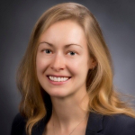

GRAPLEr: a new R package
Authors: K. Subratie, S. Aditya, S.S. Mahesula, R. Figueiredo, C.C. Carey, and P.C. Hanson
Creates offsets for GLM met file variables (e.g., add +2ºC to all temperature values in a met file), submit the jobs via a Web service to run on other computers, and then analyze the output
See: http://graple.org/
Notes:
To remedy this problem, we are going to use a new R package called GRAPLEr that creates constant offsets (e.g., +2ºC added to all observational air temperature data) for GLM met variables, submits the jobs via a web service to run on other computers (distributed computing), and then returns the model output to us.

Slide 23


What is distributed computing?
A model of computing where multiple networked computers work together towards a single problem, dividing the problem into many parts that are solved by different computers
Notes:
Many ecology students are not familiar with distributed computing, so a little background here may be helpful.
The GRAPLEr Web service divides the problem into many parts, HTCondor (a computer job scheduler program) dispatches them to be solved by different computers, and IPOP provides the network.

Slide 24





GLM in your computer
You + a computer
Get response variables from output.nc file,
visualize model output using glmtools package
Manually edit
.nml & .csv files
Load files
using R
Use GLMr package to run 1 simulation
Notes:
A schematic of the workflow for one GLM simulation: you submit one GLM simulation to R on your computer, with an nml and met CSV file. R (via the GLMr package) runs the model, and then provides output that you can access via glmtools.

Slide 25
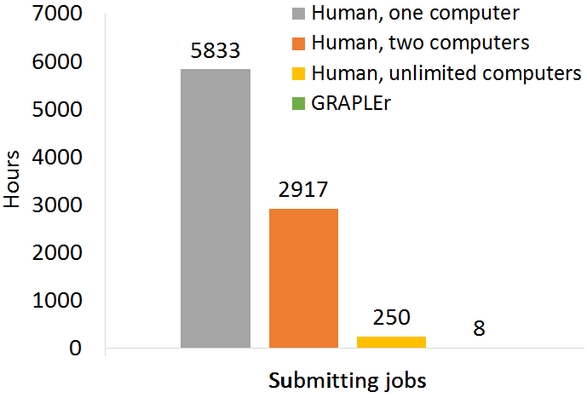
GRAPLEr expedites simulation modeling
Enter distributed computing:
  Run 100s to 1000s of GLM jobs
  Take each GLM job and dispatch to a different computer across the Internet
  Shorten execution times for large numbers of model runs (e.g., climate change offsets)
  A superhuman could manually submit <100 simulations in an 8-hr day
Distributed computing is not easy– but GRAPLEr makes it easy for you!
  Can submit jobs directly from R user interface
Notes:
We now scale up one simulation to many using the GRAPLEr.
GRAPLEr does three things:
1) creates many simulations with unique met_hourly files per your specifications,
2) distributes the simulations to many computers so that hundreds of runs can happen in the time it takes one on your computer, and
3) returns the output to you via R.
In the figure, it shows how many hours it would take to run 100,000 jobs: 5833 hours for one human to manually configure and run the simulations individually, vs. 8 hrs for GRAPLEr (and you don’t have to do much more than press some buttons and let the computers do the work!)

Slide 26




GRAPLEr in action
Get response variables from output.nc file for each simulation,
visualize output from 1000’s of model runs using glmtools package
R + GRAPLEr
package
GRAPLEr creates new .nml & driver files for each simulation…
…then uses the cloud to distribute simulations to many computers
Specify range of simulations with .json file
You + a computer
Notes:
A schematic of the GRAPLEr workflow: you submit one GLM simulation to R on your computer.
The GRAPLEr creates hundreds of new simulation files following your specifications (each with small tweaks in their met files), based off of that one original simulation.
The GRAPLEr then distributes those hundreds of simulations to run on other computers via HTCondor (a computer job scheduler), and returns the output to you, which you can query in R. Voila!

Slide 27
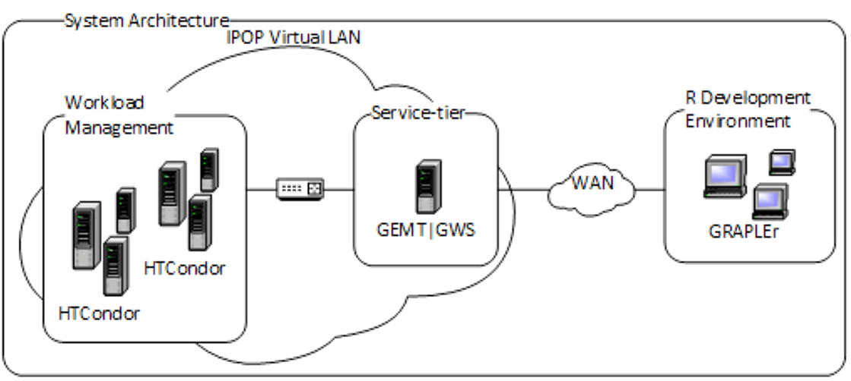
GRAPLEr in action
Web service: A server takes requests from you through R
IPOP network overlay: Aggregates computers across the Internet as if they belong to the same domain within the cloud
HTCondor: Distributes GLM jobs to the computers connected by IPOP so they can run concurrently and finish faster
Figure: Subratie et al. 2017
Notes:
OPTIONAL SLIDE:
Some more computer science information on how GRAPLEr works, which is not necessary to know for running the module but might be interesting for advanced students.

Slide 28
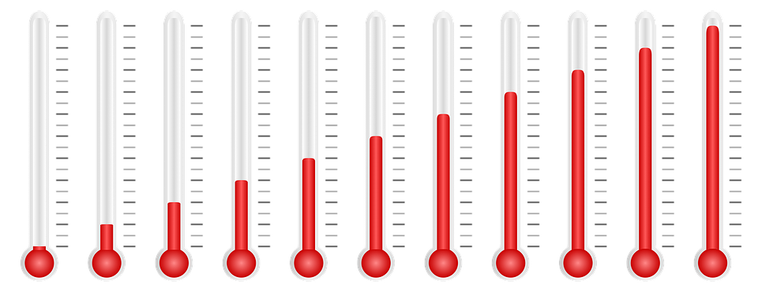
Activity C
Go through the GRAPLEr demo in the R script
Once you have finished the demonstration, design your own simulation "experiment" with your partner and use the GRAPLEr to examine the offsets of a meteorological variable and magnitude of your choice.
Create some figures from your simulation and share them with the class.
m day⁻¹
m day⁻¹
Image: Pixabay public domain
Notes:
Tell the students to return to their R scripts to run the demo for Activity C.
Depending on the amount of available time left in the teaching period, you could encourage advanced students to create their own simulation experiment beyond the demo using the GRAPLEr, which they can share with the other students, similar to Activity B.

Slide 29

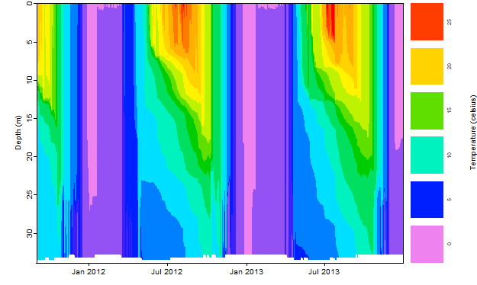

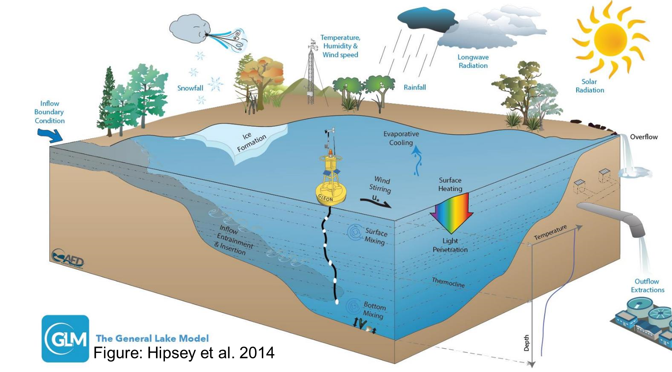
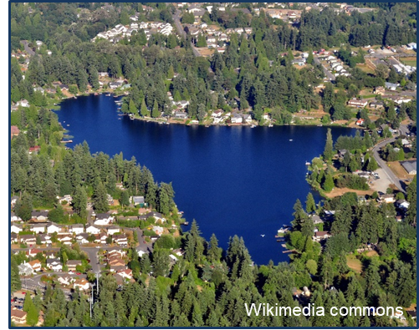
Thank you for participating!

